Slide 1
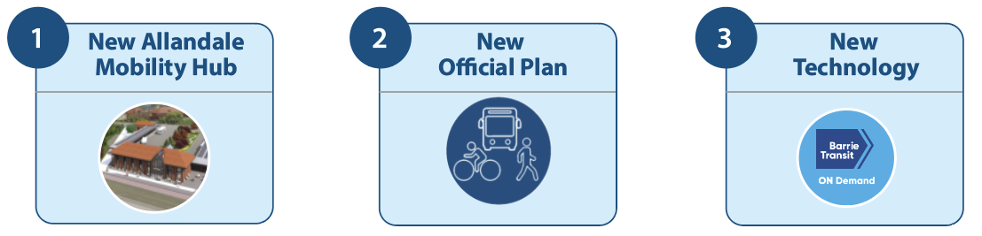
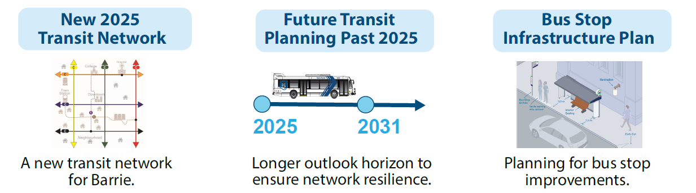


New Transit Network
DRIVERS FOR CHANGE
RESULT

Slide 2
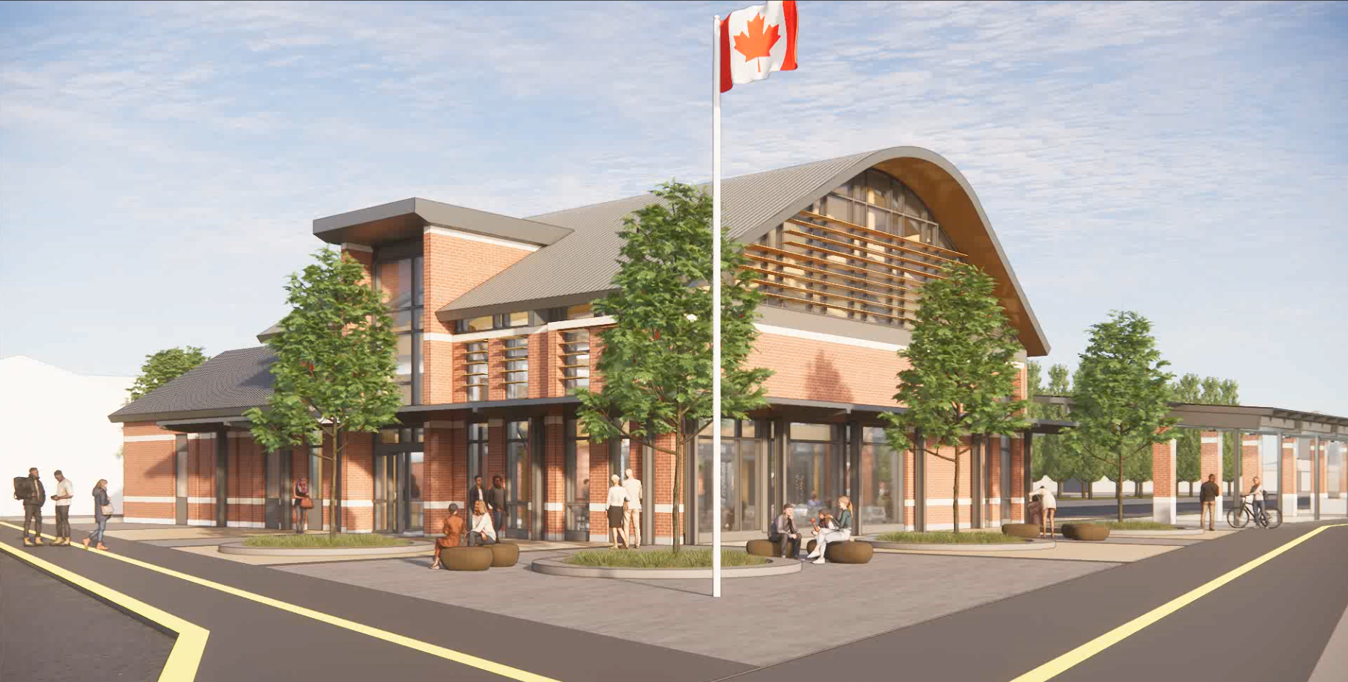
New Allandale Terminal

Slide 3
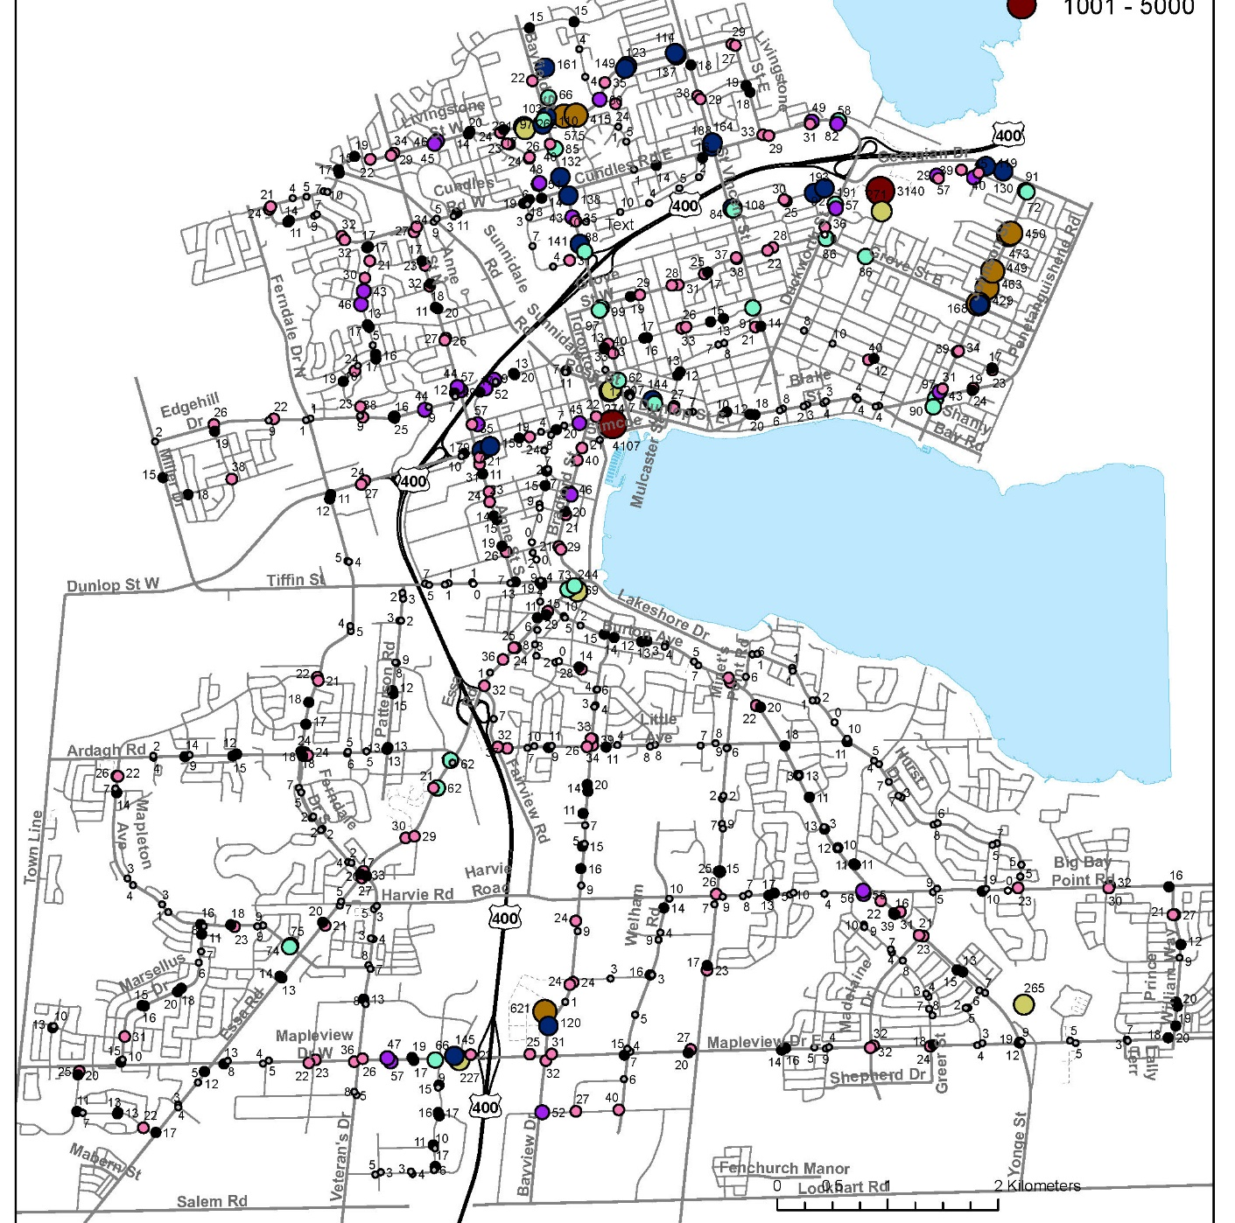
Service Planning
Boardings and Alighting's (Fall 2023)

Slide 4


Phased Implementation
Lessons Learned
Reduce Impact
Focused Resources
Raise Awareness
TOD overlapping (4-week)
ease transition

Slide 5
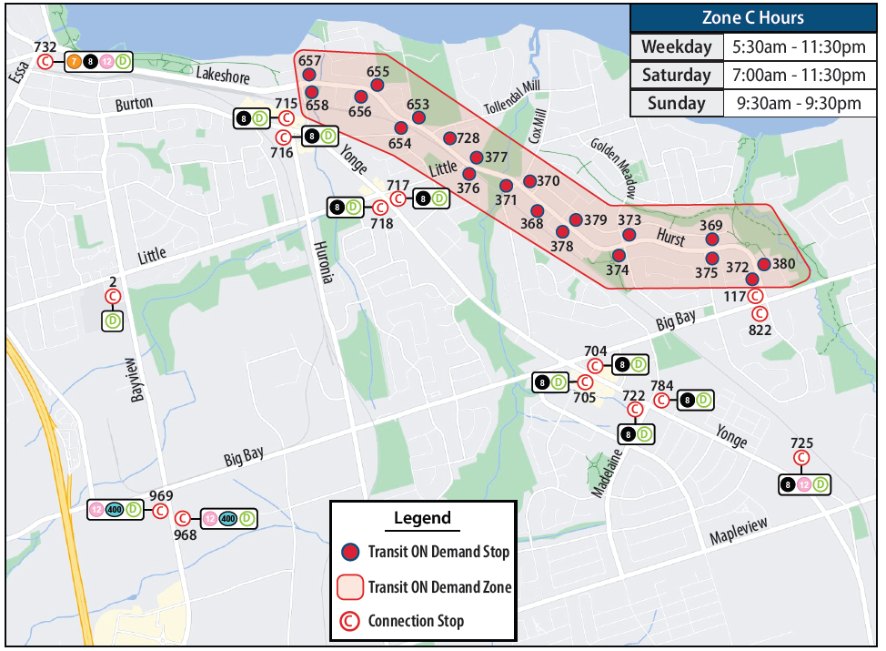
Transit ON Demand Zone “C”

Slide 6
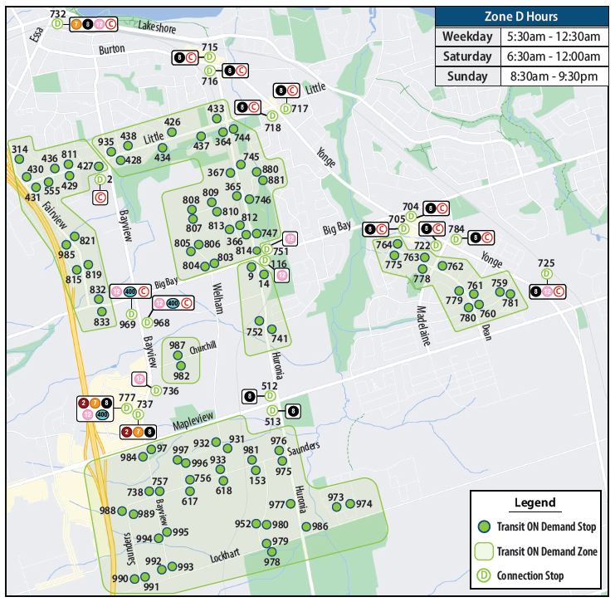
Transit ON Demand Zone “D”

Slide 7
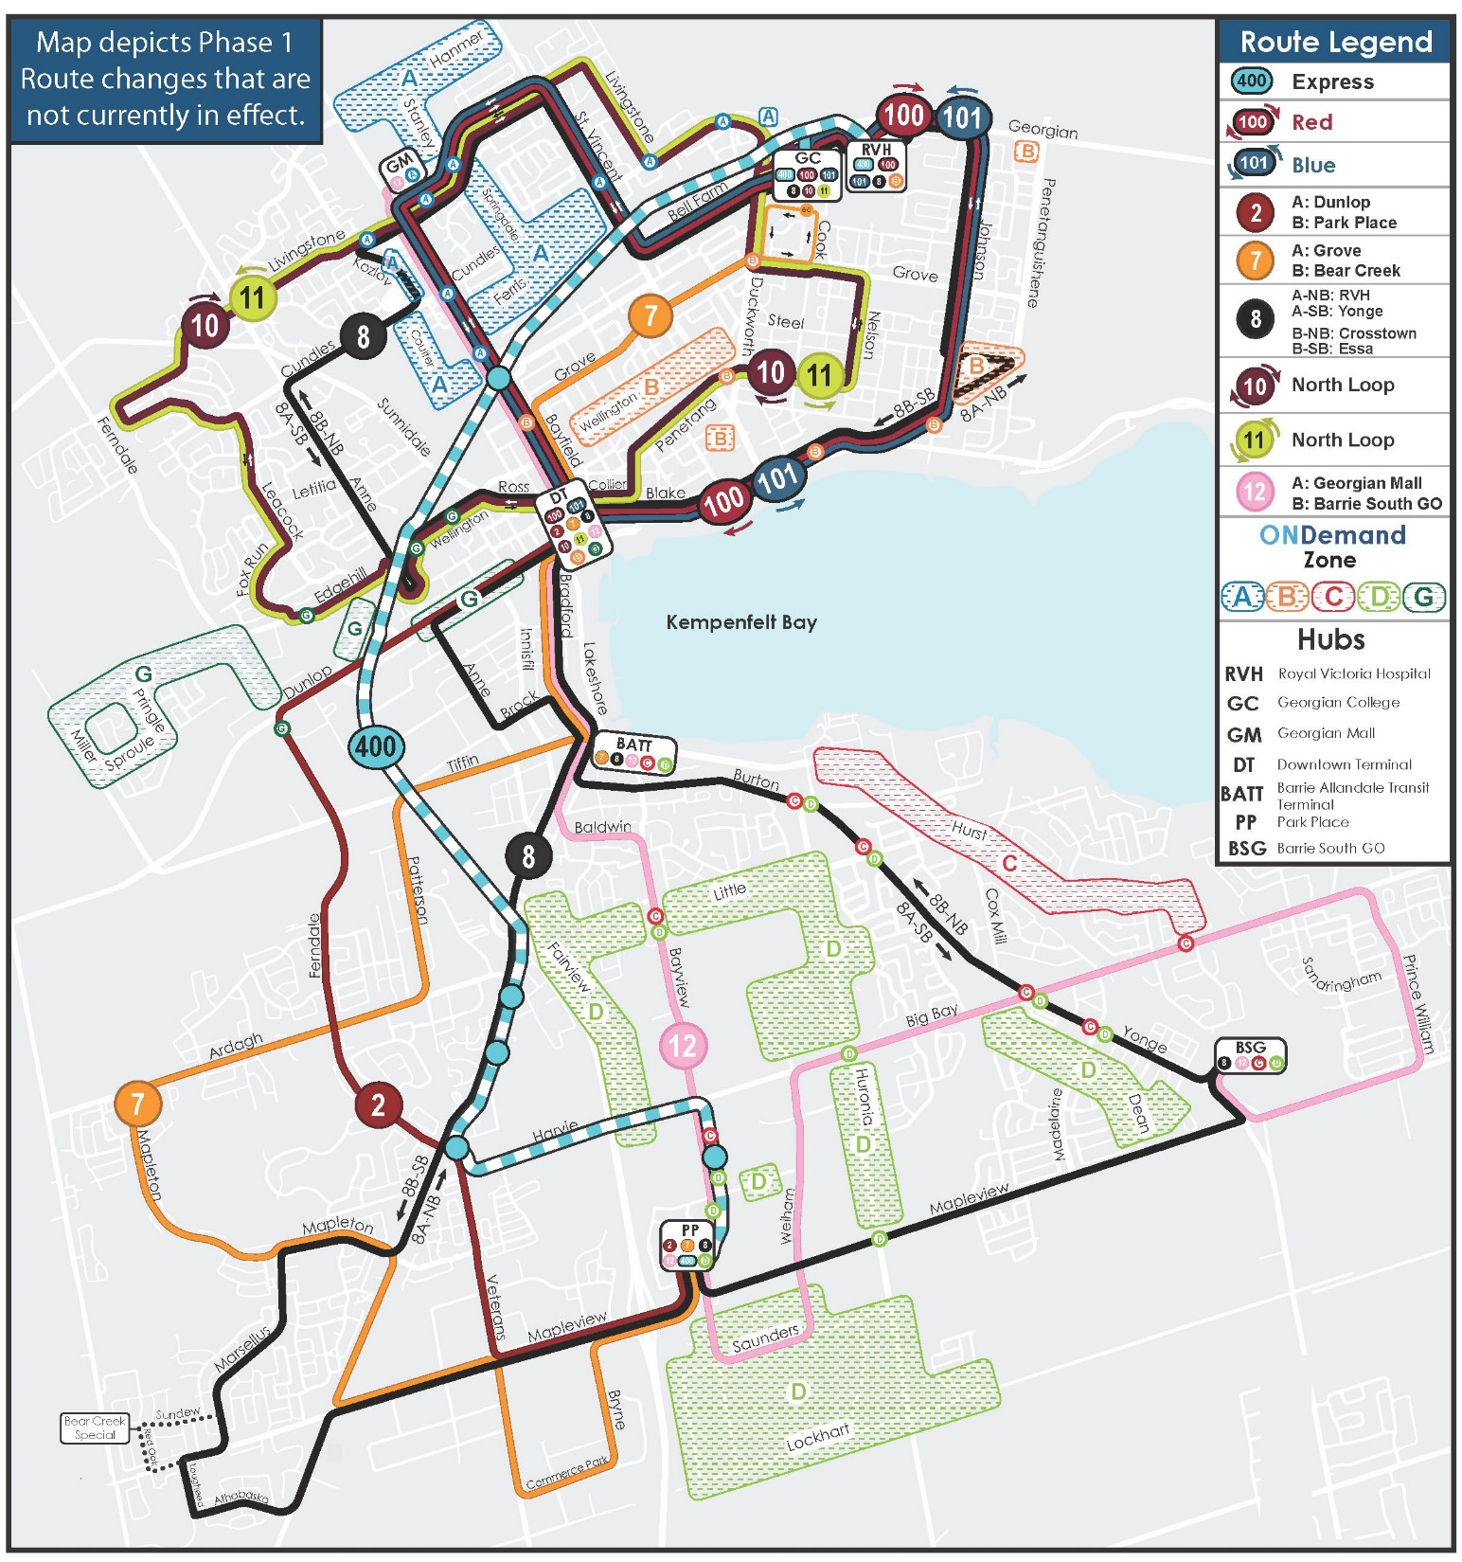
Phase One
June 2nd

Slide 8
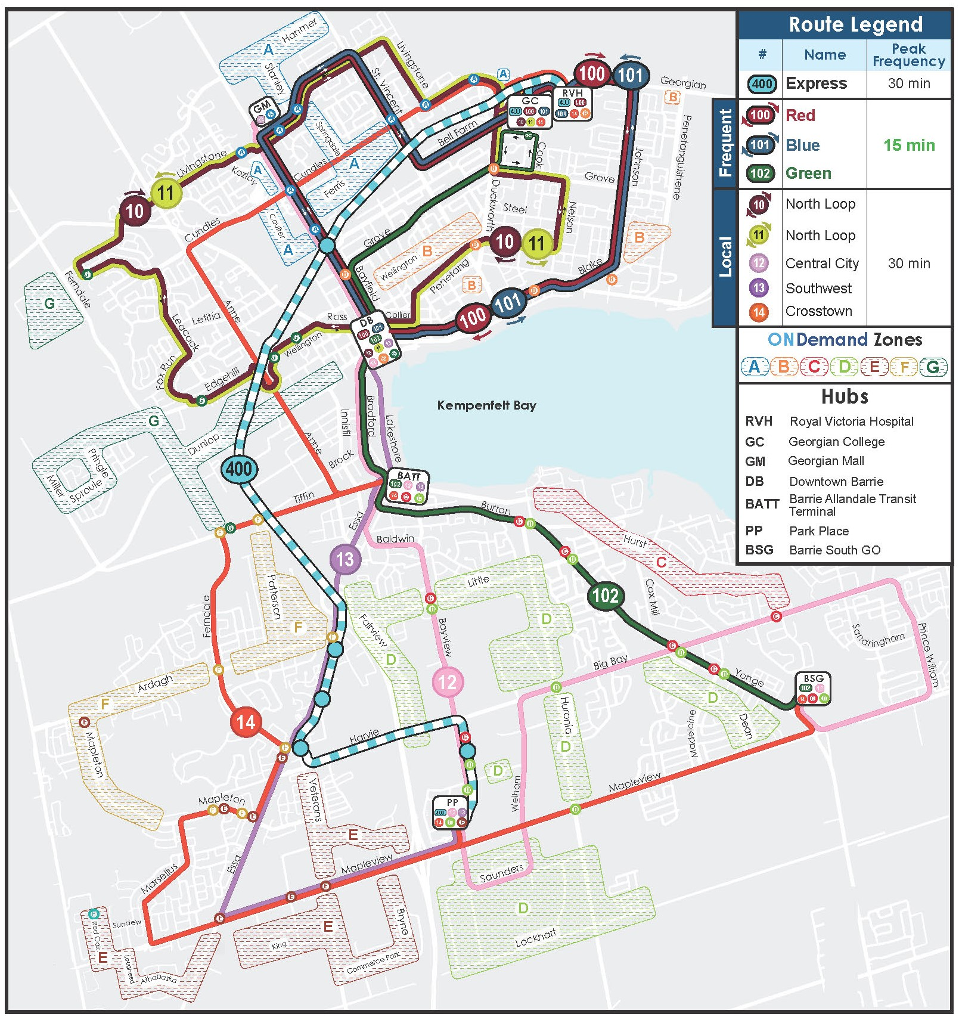
Phase Two
Mid-2025

Slide 9
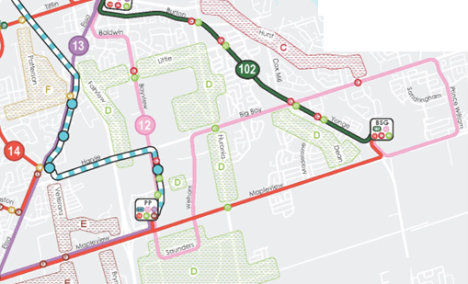
New Transit Network – Ward 9 & 10 Highlights
Directly connect to 400 Express service
15-minute frequency corridor
Service newly developed
areas in 2025

Slide 10

Service Improvements
Reduce cross city travel times
Increase frequency
More reliable
Maintain coverage
Decrease local travel times
23 minutes quicker cross city
70% of riders with direct access to frequent service
Amelia, Benson, Little Lake
13% reduction

Slide 11
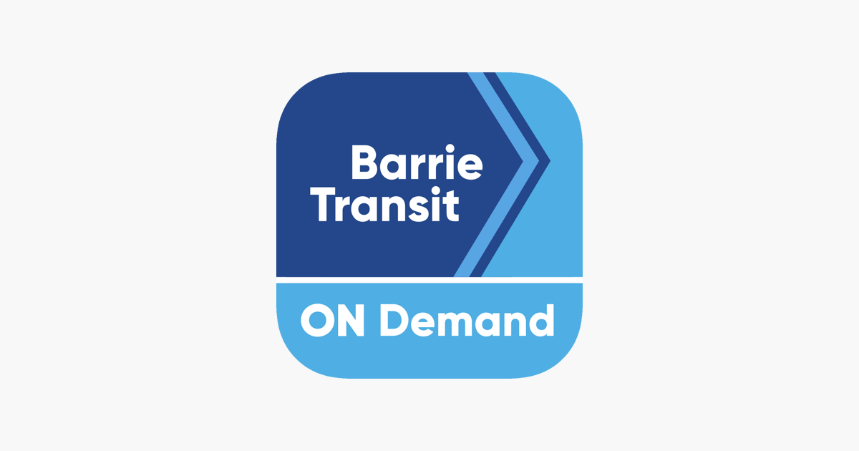



QUESTIONS
*TRIP PLANNER PRE-LAUNCH*

